Slide 1
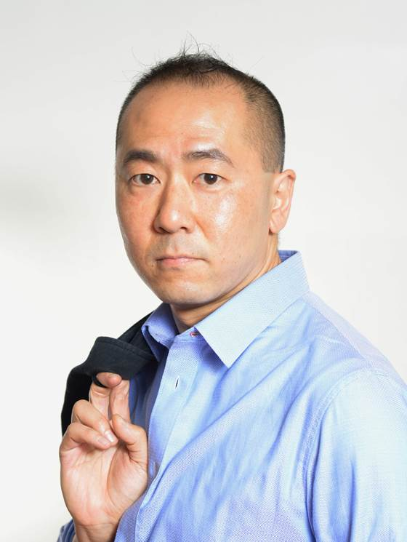
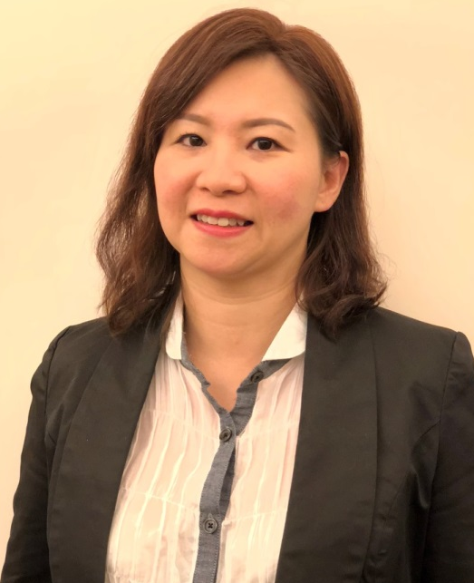
Websolutions：新計劃、新機會
Websolutions: New Programs, New Opportunities
Matthew Lai
Joyee Wong
主管經理級
Master Coordinator
經理級
Executive Coordinator
四個佣金週期共賺取 HK$16,100
HK$16,100 in 4 Commission weeks
四個佣金週期共賺取 HK$11,500
HK$11,500 in 4 Commission weeks
本簡報中提到的收入等級純屬舉例說明，無意代表美安香港超連鎖™店主的一般收入，也無意表示任何超連鎖™店主皆可賺取同等收入。美安香港超連鎖™店主的成功與否，取決於其在發展事業時的努力、才能與投入程度。
The income levels mentioned in the following presentation are for illustration purposes only. They are not intended to represent the income of a typical Market Hong Kong UnFranchise ™Owner, nor are they intended to represent that any given Independent UnFranchise ™ Owner will earn income in that amount. The success of any Market Hong Kong Independent UnFranchise ™ Owner will depend upon the amount of hard work, talent, and dedication which he or she devotes to building his or her Market Hong Kong Business.

Slide 2
FOLLOW ME ON SOCIAL MEDIA
@wong.joyee
facebook.com/Joyee Wong Chi Yin
@joyeewong6

Slide 3
[
]
B2B OPPORTUNITIES
MAWEBCENTERS
Notes:
SR

Slide 4
MAWEBCENTERS
IMPACT
UFO
GROUP
CLIENT
PROFITABILITY
How can it impact your short and long term income?
BUSINESS BUILDING
How can it impact your organization?
BENEFITS
How can it impact your client’s business?

Slide 5
UFO PROFITABILITY
When considering any business venture, you want to evaluate how it can impact your income long & short term.
SHORT TERM GOALS
Your short-term financial goals can typically be handled by increasing cash flow (RETAIL PROFITS)
LONG TERM GOALS
Your long-term financial goals can typically be handled by increasing ongoing income (MPCP)

Slide 6
AVERAGE WEBSITE RETAIL PROFITS
USA, MX, CAN, AU: $1,000
UK: £700
HK: HK$7,700
TW: NT$32,000
ES: €800
Let’s take a look at earning potential
Retail Profit
BV
BV
Website Sale: 230 BV
Active Website Client: 30 BV / mo.
Digital Marketing Sale: 5-100 BV & Profit/mo.
Growth Potential
Notes:
TRAINER’S NOTES:
Earning potential will be demonstrated in terms of short term and long term growth potential

Slide 7
The Design Center ADDS VALUE
PRICING RESTRUCTURE
Design packages will be increased and will include retail profit and increased BV!
WHY?
Incentivize you (more BV/ Retail Profit) because clients want/need design
More marketable to sell a redesign every 2 years or so
Notes:
TRAINER’S NOTES:
Including the design center helps you make more sales at a higher price and Sales support will sell the packages for you.

Slide 8
YOUR ORGANIZATION
In our business, you don’t want your “major” to distract from overall business building.
GROUP BUSINESS VOLUME
BV & IBV from customer sales is “Autoship” in nature. How does that add up?
(Group Business Volume)
SHOPPING ANNUITY
Do WebCenter Owners spend money?
How does your client’s spending compare to an average family spending?

Slide 9
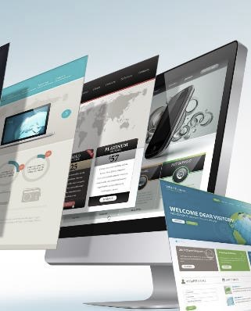
Each website sold
generates 230 BV
Each active client
generates
5, 30 or 35 BV / Mo.
DIGITAL MARKETING PRODUCTS GENERATE ADDITIONAL BV AND RETAIL PROFITS
Notes:
TRAINER’S NOTES:
Long Term Potential for WCOS = Ongoing BV and Retail Profits

Slide 10
YOUR CLIENT
Consumers of tech products tend to care more about ”What” the product does more than “How”
BUSINESS EFFECTS
We help to increase revenue, engagement and satisfaction while decreasing expenses and streamlining business practices.
SIMPLICITY
Marketing a business is more complex than it was years ago. We simplify by having a comprehensive marketing solution.

Slide 11
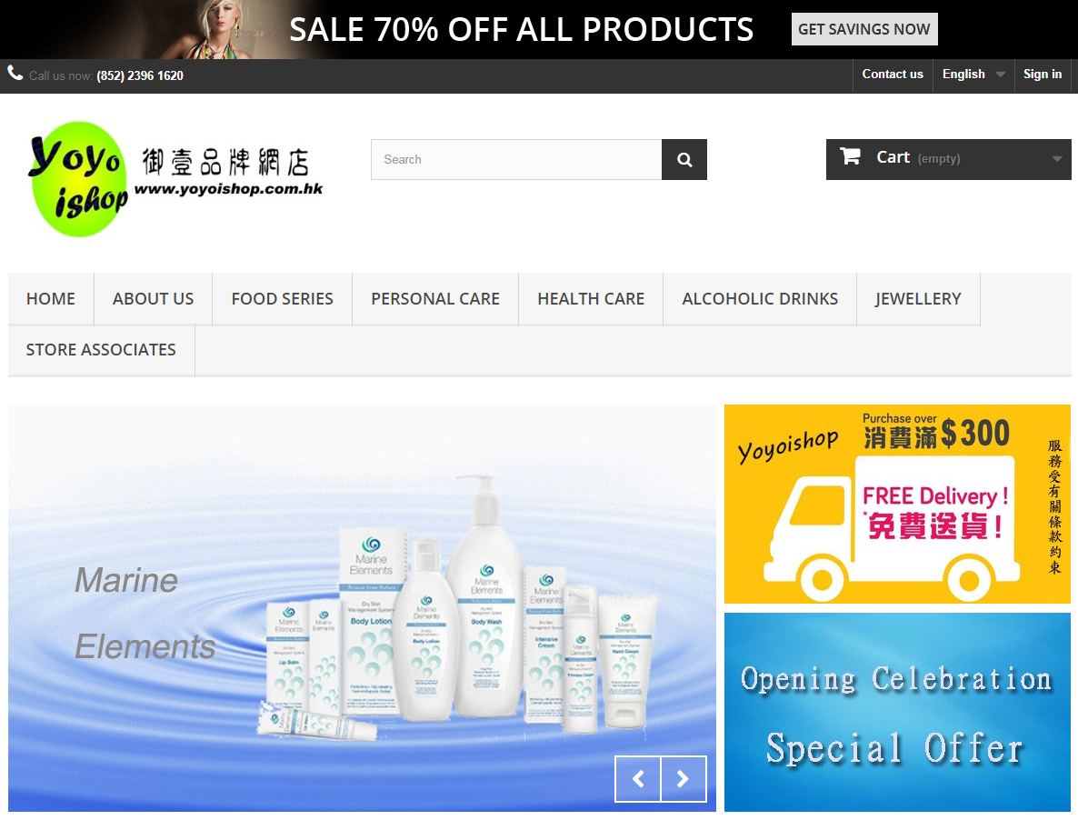
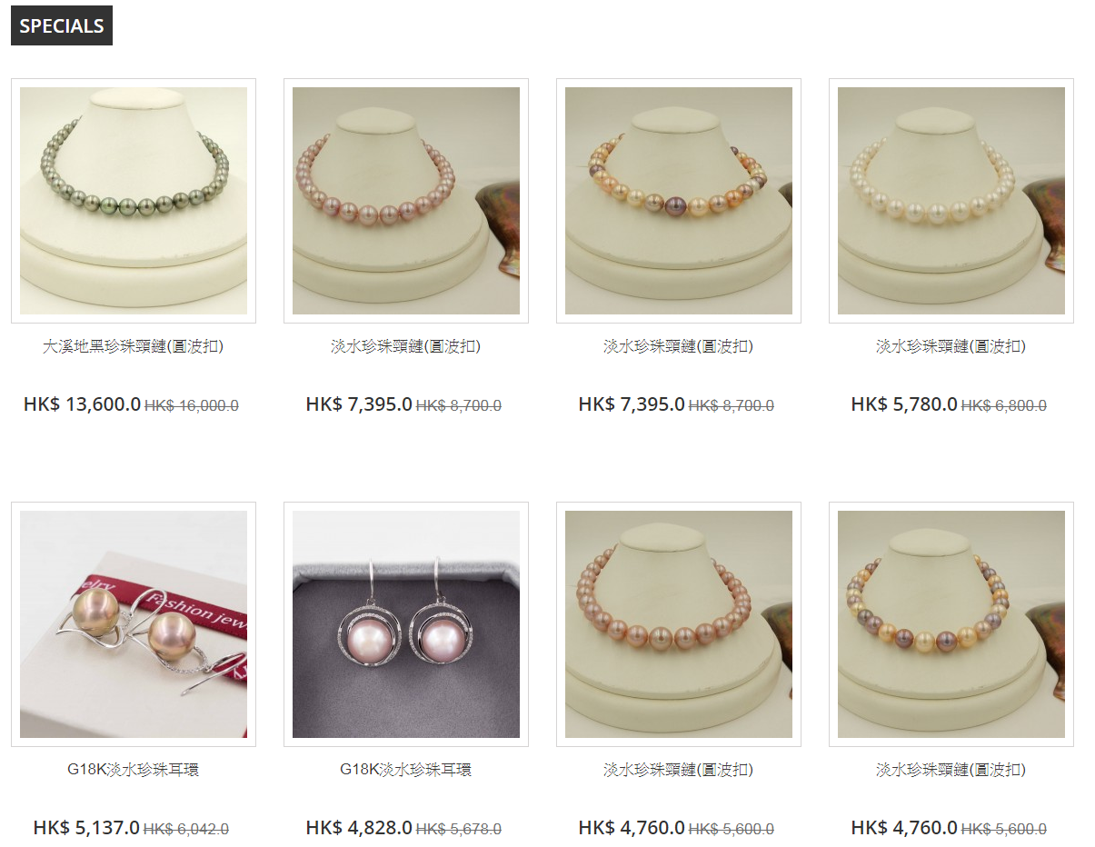
Case SHARING: BEFORE
YoYo ishop
The old website does not have “Slider” function to display new products, with poor membership function and simple shopping cart function only.
Now:
The new design is mobile responsive in different devices
comprehensive member setting and registration procedure, attract new customers
equipped with full shopping cart functions, website admin can set the selling price and discount easily
Interact with customers by instant messages and social media platform
Before
Notes:
Trainers Notes:
Before and After
Having a better online presence can result in more sales because of the convenience of online registration, class selection and research
It also saves time when your website is built to answer most questions and allow consumers to conduct research

Slide 12
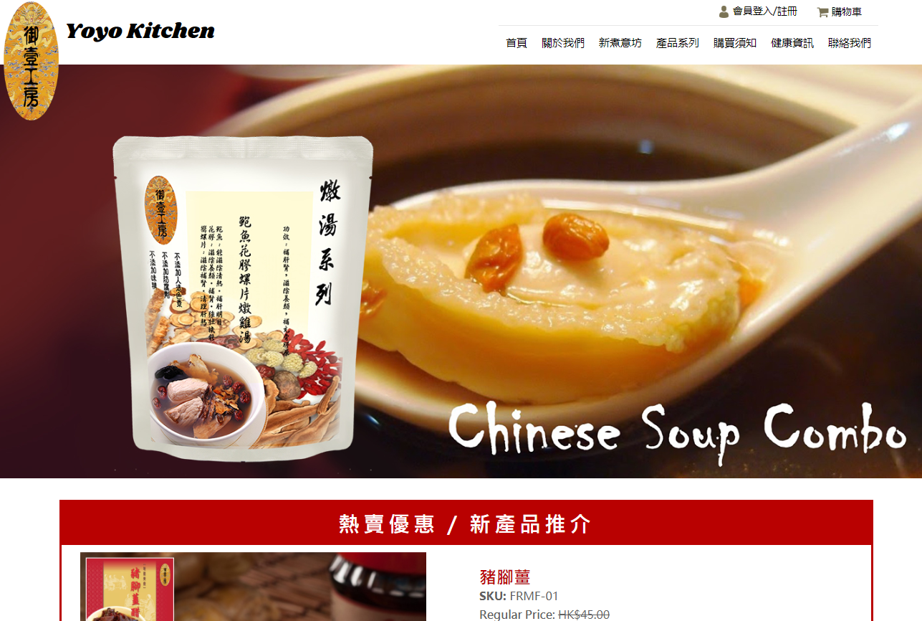
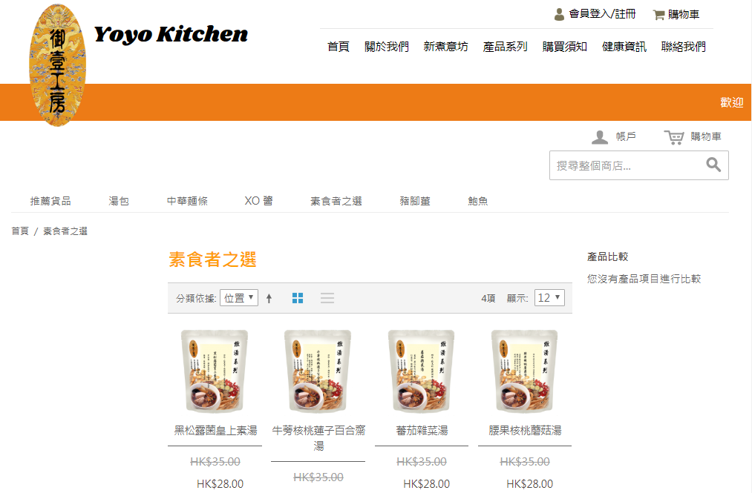
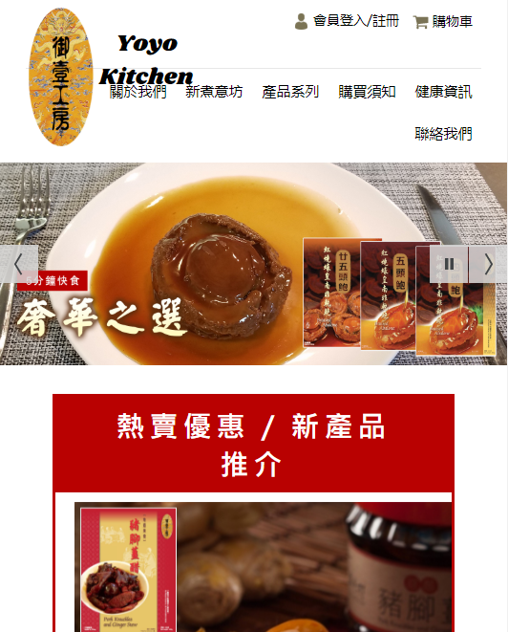
Case SHARING: BEFORE
Yoyo kitchen
Case SHARING: AFTER
Yoyo kitchen
Notes:
Trainers Notes:
Before and After
Having a better online presence can result in more sales because of the convenience of online registration, class selection and research
It also saves time when your website is built to answer most questions and allow consumers to conduct research

Slide 13
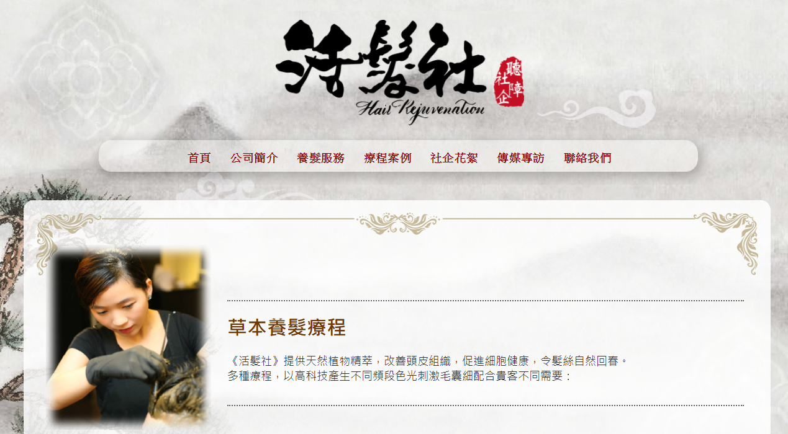
CASE SHARING: AFTER
Hair rejuvenation
CASE SHARING: BEFORE
Hair rejuvenation
The old website is not a responsive web design, it does not included interacting function.
WebCenter helps the shop:
Display the service content
Build a professional image
Responsive web design can enhance customer’s experience
Interact with custustomer directly by social media platform and instant messages
BEFORE
Notes:
Trainers Notes:
No before site
Self explanatory

Slide 14
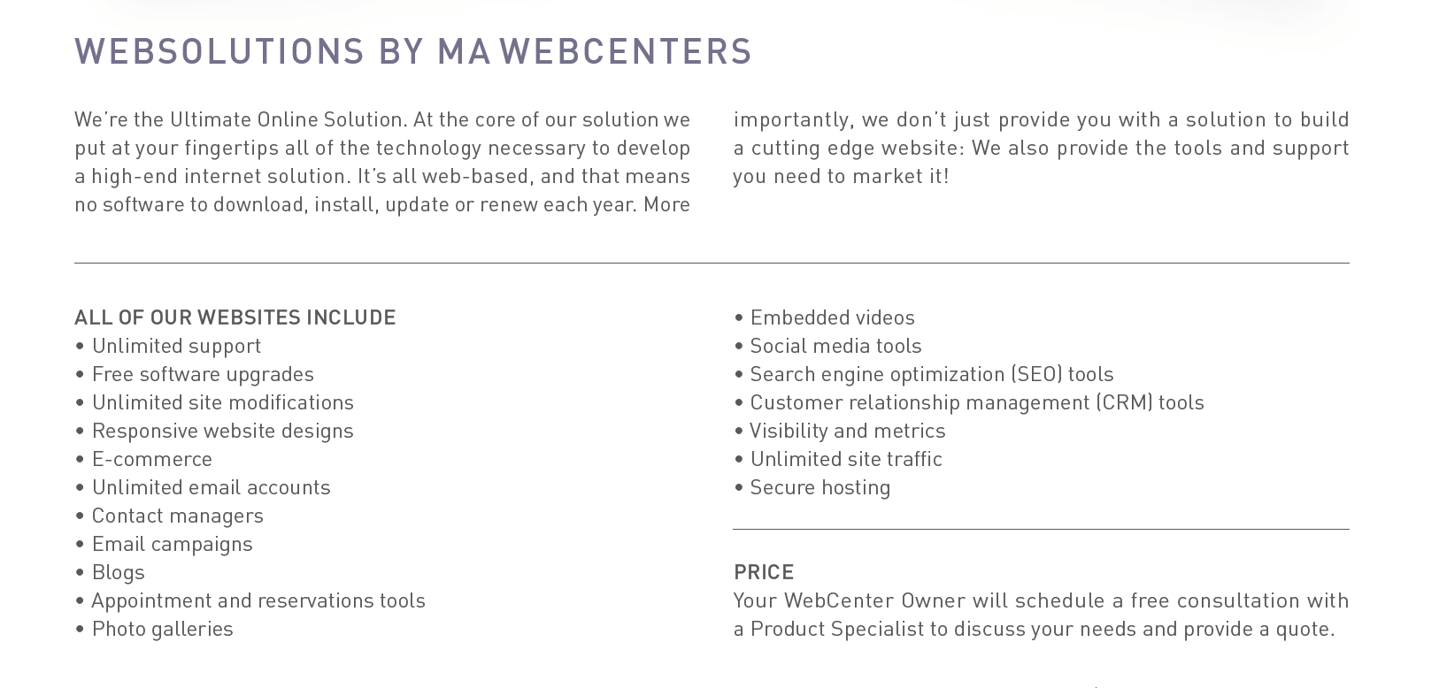
MORE THAN JUST A WEBSITE
[English only]
[English only]
Notes:
Trainers Notes:
This is just an intro slide – The goal here is to get them excited about what we are going to talk about.
In brief, cover the big topics “Websites, Marketing Tools, Unlimited, Support, Security)
The goal is to paint a simple picture of how all –inclusive our solution actually is / Instill confidence in the product.
Spend 1 minute or less on this slide – the details are coming up!

Slide 15
WHAT’S NEW WITH WEBCENTERS?!
IMPROVED
&
NEW
NEW RESOURCES
&
TOOLS
MONTHLY TRAINING
Notes:
TRAINER’S NOTES:
We’ve all set some initial goals but did we take them seriously?
Did you hit your goals in the past? Why /Why not?
Was your action plan on track to help you get what you want?
Revising your goals will help to create smarter goals with proper action plans
Better action plans = better quality work time AND better quality play time

Slide 16
www.mawc411.com
TECH RESOURCES & TOOLS ITEMS TO LEVERAGE TO INCREASE SALES & RECRUITING WITH MAWEBCENTERS
Notes:
TRAINER’S NOTES:
STEP 1 – Generate leads / prospects/ candidates
It’s a critical step that many people rush through or completely skip. If you don’t take the time to generate a healthy list to start with, you can quickly run out of possibilities to work with.

Slide 17
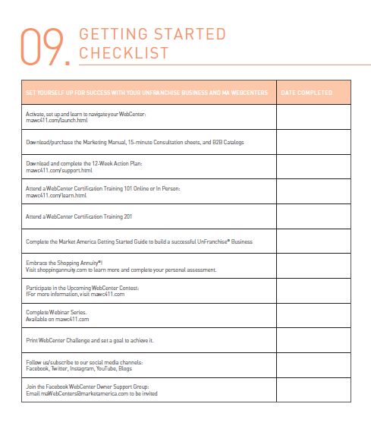
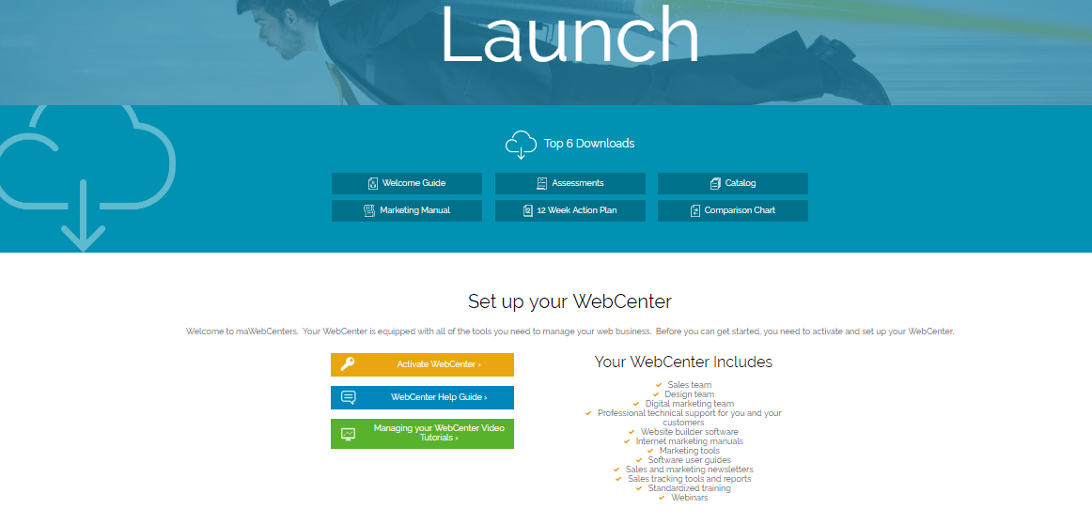
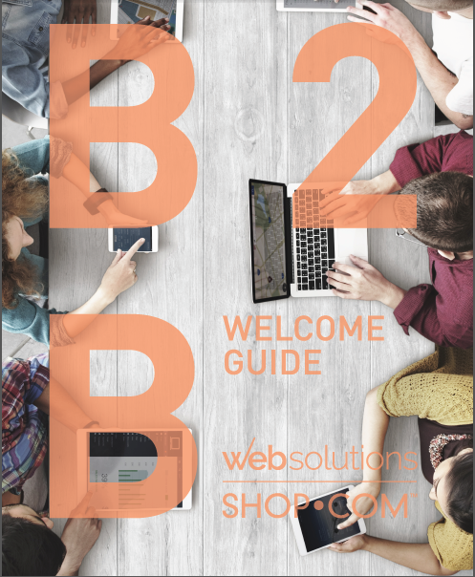
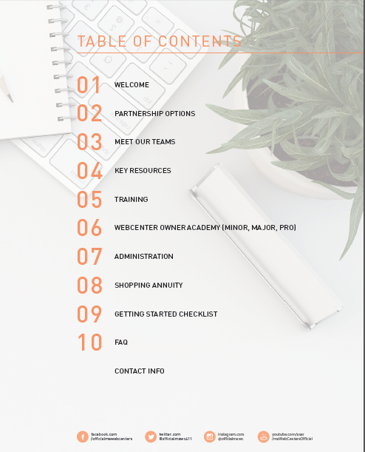
Notes:
JP

Slide 18
NEW
MONTHLY TRAINING & SUPPORT
We’ve put together four types of monthly campaigns and support for you.
Free to join and leverage for your success!

Slide 19
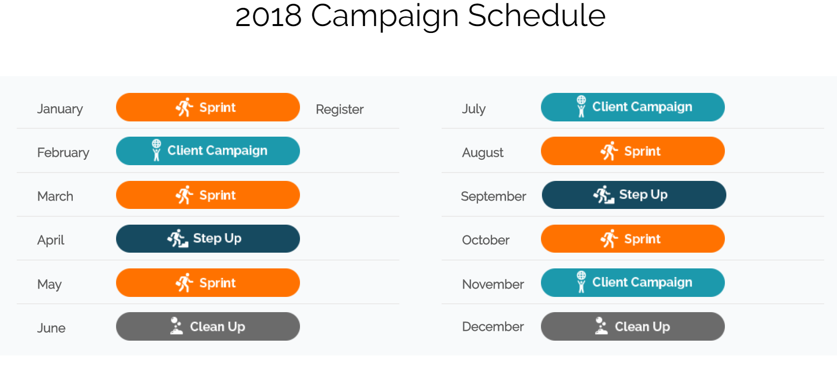
MONTHLY TRAINING & SUPPORT
MONTHLY TRAINING
& SUPPORT

Slide 20
MONTHLY TRAINING
& SUPPORT

Slide 21
CONSULT TO CLOSE WEBCENTER CONTEST
INDIVIDUAL AWARDS
ALL AROUND AWARDS
MOST COMPLETED WEBSITE APPOINTMENTS:
Maggie Su, HK
MOST COMPLETED DMP APPOINTMENTS:
翁宗標 & 蘇惠琴, TW
MOST WEBSITE SALES:
Heidi Ripplinger (USA)
Carla Churyk (USA)
Maggie Su (HK)
MOST DMP SALES:
Stephen Teng, USA
1st PLACE: Maggie Su, HK
2nd PLACE: Semerah Killingeck, UK
3rd PLACE:翁宗標 & 蘇惠琴 , TW
4th PLACE: 張維苓, TW
5th PLACE: Heidi Ripplinger, USA

Slide 22
CONSULT TO CLOSE WEBCENTER CONTEST
1st PLACE: Maggie Su (Hong Kong)

Slide 23
TIME TO TAKE ACTION
WEBCENTER EVENT SPECIAL
FREE WEBCENTER SETUP Order on UF:
HKWCSP (New activation)
HK6051RA (Reactivation)
Notes:
TRAINER’S NOTES:
Self explanatory

Slide 24
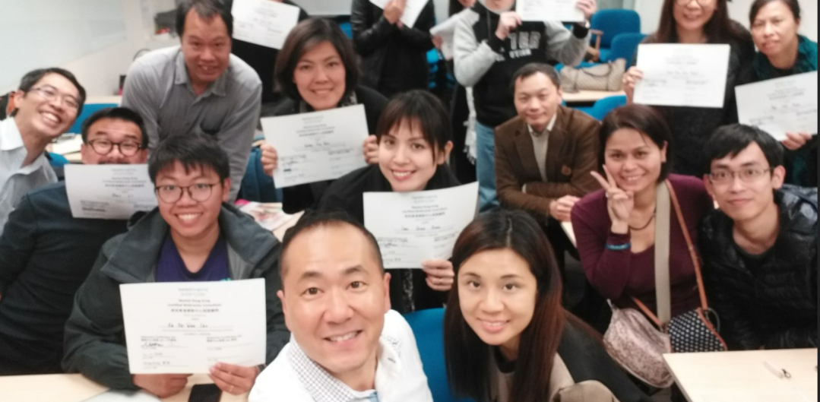
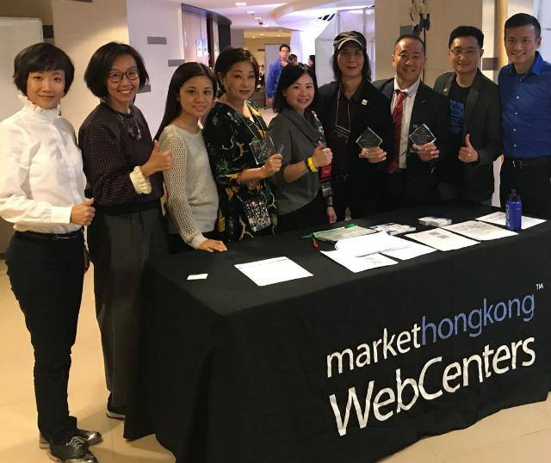
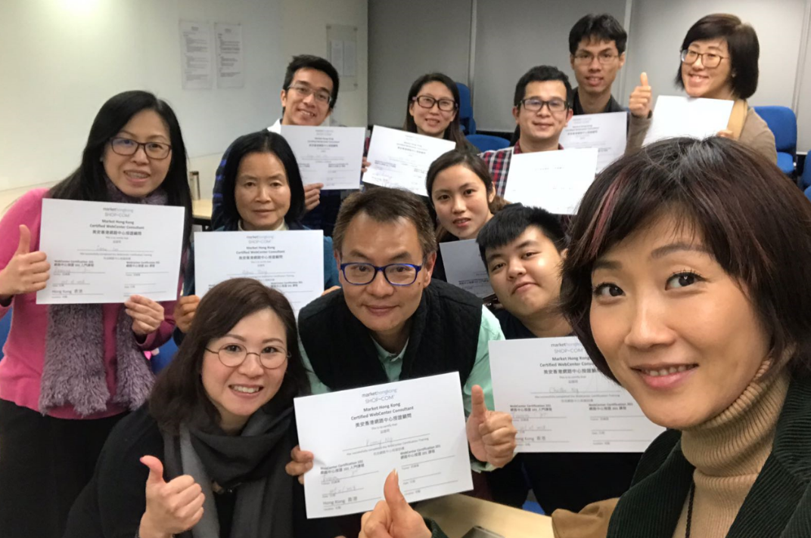
Check the Latest WebCenter Trainings on GMTSS

Slide 25
[
]
B2B OPPORTUNITIES
MAWEBCENTERS
Notes:
SR

